Slide 1
Overview of HIV Prevention Cascade Discussions. Geoff Garnett
July 2019

Slide 2
Why prevention cascades? (or something similar with a different name)
Logical framework summarizing actions taken by individuals across a population that can prevent HIV acquisition.
Management tool to focus on challenges and gaps and identify potential to improve impact. (does not define the interventions that would reduce the gaps).
Advocacy tool – indicating points for intervention.
What is difference from treatment cascade?
Denominator more certain for treatment.
More restrictive options for reducing viral load than preventing HIV acquisition.
The same challenges of patients moving in and out of care and suppression and needing long term suppression apply.
We are learning that using a homogeneous denominator for treatment leaves gaps.

Slide 3
Areas for debate as we develop this idea:
Who is at risk of HIV and when, with what level if risk? How should the denominator be defined?
How do we account for changing underlying risk over the life course?
Is there one cascade? Multiple modes of prevention (and treatment) – how to combine?
What duration should the prevention cascade cover?
How to account for dynamics of transmission?
Relationship to programmatic activities and coverage of packages?
Role of HIV testing?
Measuring or estimating the impact of prevention?
Is the data available?
Is there a need to standardize?
How many angels can fit on the head of a pin?

Slide 4
HIV Prevention Cascades: Guidance to the Field (Draft under revision)

Slide 5
Similar to concepts of hazard and preventable fraction:
Incidence(t) = N(t)*risk(t)*(1-(efficacy*adherence*coverage))
This only looks at the risk of acquisition – not the transmission dynamics, so provides a minimum for impact.
Defines efficacy as biological protection – analogous to according to protocol from trials.
For treatment can take a cross sectional view, but in treatment cohort view is more meaningful for success of program and survival.
For prevention cascades a cohort view is more appropriate (as it is for treatment cascades).
People do experience periods of risk and covering these should be the aim.
In the GOALS model used by UNAIDS to explore the impact of primary HIV prevention N(t) the number at risk, efficacy, and effective coverage are used for each mechanism of prevention.

Slide 6
All HIV prevention requires behavior change and behavior change occurs within an environment and communities – we cannot think of biomedical tools without considering structural drivers, behavior change and communities.
STRUCTURES
BEHAVIORS
Laws
Sexual behavior
DIRECT MECHANISMS
Policies
Demand & uptake
Partner reduction
Social, cultural and economic environments
Condoms
Exposure and transmission
Adherence &
retention
VMMC
Oral PrEP
Regulatory and product introduction pathways
Provider motivation
Long acting cabotegravir
Delivery systems
Combination prevention interventions.

Slide 7
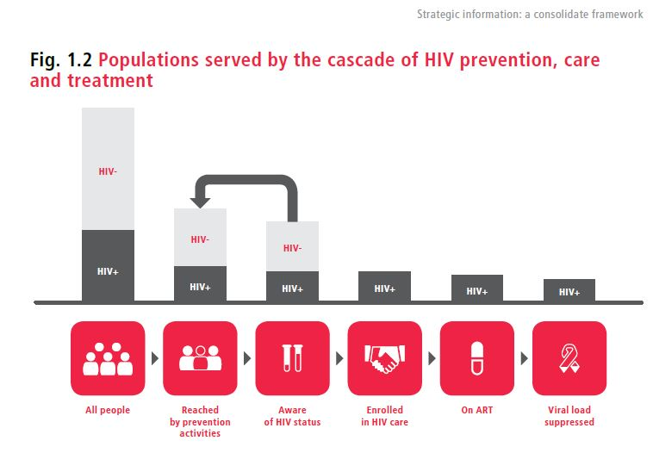
WHO Guidelines on strategic information, 2015

Slide 8
Population at risk of acquiring HIV
Identification of vulnerable population
Ward et al (JIAS 2019)
HIV testing
HIV untested, status unknown
Linkage
HIV negative
Care and treatment
HIV positive
Program packages –
Marketing, care services, commodity supply,
community engagement, incentivization, empowerment.
Use of cascade analysis:
Prioritized options providing direct protection.
Young men
- circumcision
Young men and women - condoms
Young men and women – oral prep
Prioritize largest gaps
Analyze causes
Develop and test interventions
Deliver interventions
Do not perceive risk
Do not perceive risk
Do not perceive risk
Gaps in protection
Unwilling to be circumcised
Unwilling or unable to use condoms
Unwilling or unable to use prep
Would otherwise remain at risk over period
Lack of efficacy of circumcision
Inconsistent use
Inconsistent use
Lack of efficacy
Lack of efficacy
Protected
Protected by condoms
Protected by prep
At risk
Adhere to prep
Perceive risk
Adopt oral prep
Efficacious

Slide 9
Who is in the denominator population?
Population at risk of acquiring HIV
Identification of vulnerable population
HIV testing
HIV untested, status unknown
Linkage
HIV negative
Care and treatment
HIV positive
Major difference from treatment cascade.
Could vary from those who would certainly acquiring infection over period of interest to everyone – neither is sensible; should be those at risk that programs are aiming to prevent infection in.
Cascade shows proportional reduction in risk regardless of how well focused.
The better focused on those at risk the more cost effective the interventions will be or the more willing we should be to spend.
Should probably differ depending on the prevention intervention – i.e. more restricted for more expensive, onerous approaches.

Slide 10
One Cascade? How does the cascade relate to prevention packages or combination prevention?
Cascades differ according to population at risk and the mode of protection.
Program packages –
Marketing, care services, commodity supply,
community engagement, incentivization, empowerment.
Prioritized options providing direct protection.
Young men
- circumcision
Young men and women - condoms
Young men and women – oral prep
Do not perceive risk
Do not perceive risk
Do not perceive risk
Gaps in
protection
Unwilling to be circumcised
Unwilling or unable to use condoms
Unwilling or unable to use prep
Lack of efficacy of circumcision
Inconsistent use
Inconsistent use
Lack of efficacy
Lack of efficacy
Protected
Protected by condoms
Protected by prep

Slide 11
Use of cascade analysis:
Prioritize largest gaps
Develop and test interventions
Deliver interventions
Analyze causes
Would otherwise remain at risk over period
At risk
Adhere to prep
Perceive risk
Adopt oral prep
Efficacious

Slide 12
HIV prevention cascade for more than mode of protection.
First Intervention
Second Intervention
Lack of availability
Remain at risk
Lack of uptake
Lack of adherence/ fidelity
Lack of efficacy
Protected
Remain uninfected

Slide 13
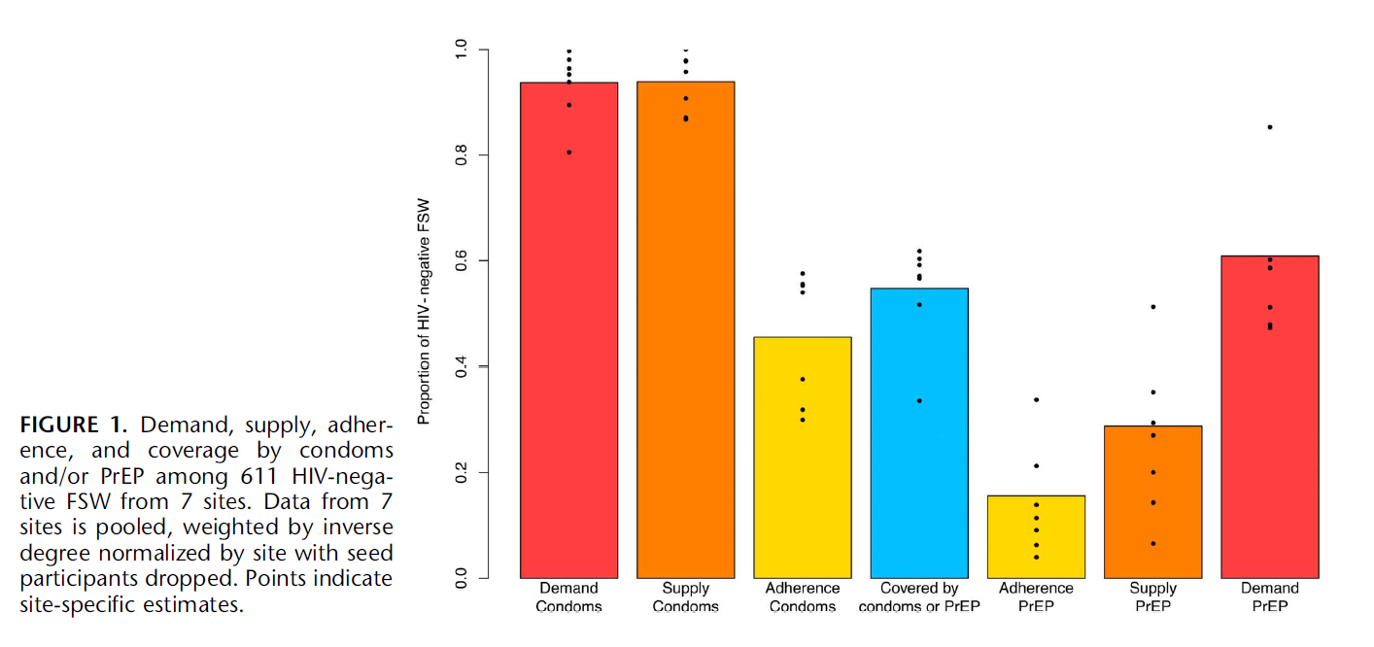
Combined prevention cascades for FSWs in Zimbabwe.
Fearon et al, JAIDS 2019.

Slide 14
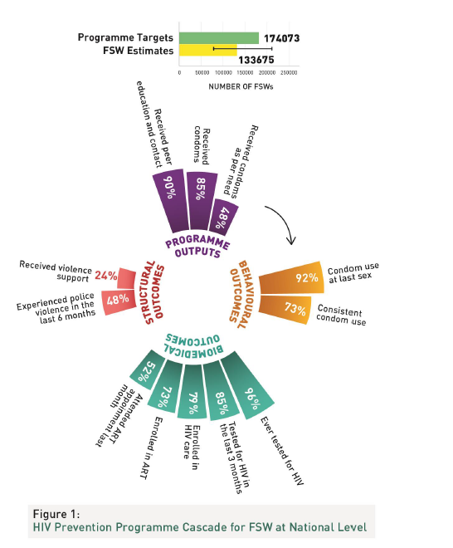
Use of prevention cascade in Kenya – Battacharjee et al (JIAS 2019)

Slide 15
Areas for debate as we develop this idea:
Who is at risk of HIV and when, with what level if risk? How should the denominator be defined?
Important task for prevention programs to identify those at risk and ensure effective coverage.
Need to define population size and risk.
Is there one cascade? Multiple modes of prevention (and treatment) – how to combine?
Trying to develop and parameterize one cascade leads to tears
How do we account for changing underlying risk over the life course?
Can trade-off tracking when people enter and leave the denominator, or include those with low risk and loose some specificity.
What duration should the prevention cascade cover?
How long is the period at risk that we are trying to cover? (units of a month or a year make sense)
How to account for dynamics of transmission?
They provide a minimum estimate of impact and can be put into transmission dynamic models.

Slide 16
Areas for debate as we develop this idea:
Relationship to programmatic activities and coverage of packages?
Coverage with a package is different from coverage of effective prevention – if we are confident the package will generate access and adherence of efficacious prevention then good. In evaluating the impact of a package we need to look at the parameters included in the cascades.
Role of HIV testing?
HIV testing is not HIV prevention, nor a necessary step in prevention cascades (unless you need to be confident someone is negative to provide prep). Testing could be used to measure incidence in a cohort, testing the impact of a prevention cascade.
Measuring or estimating the impact of prevention?
Measuring incidence ensures that we know impact – it is ideal, but difficult. Well measured coverage, adherence and efficacy should allow us to calculate (estimate) how much incidence is reduced from a prior incidence.

Slide 17
Areas for debate as we develop this idea:
Is the data available?
We need to explore this, and if it is not assess how it might be collected.
Is there a need to standardize?
Using the cascade at different levels and for different functions, with different data sources argues against standardization, but there is a danger that essential elements are missed and for routine use we need some standardization.
How many angels can fit on the head of a pin?
I don’t know.

